Slide 1



BORING CLUB 2/27/2024
GENERAL MEETING

Slide 2

PREVIOUS MEETING RECAP
WIRELESS COMMUNICATION, EasyEDA
01
02
CHASSIS CAD
03
ROADMAP TO COMPLETION
2/27/2024

Slide 3
AGENDA
EXEC SPEECHES/ ADMITTED STUDENT DAY PLAN
01
02
3D Print chassis
03
WIRELESS COMMUNICATION

Slide 4
SPEECH TIME
WHAT are you gonna do
AND HOW?

Slide 5
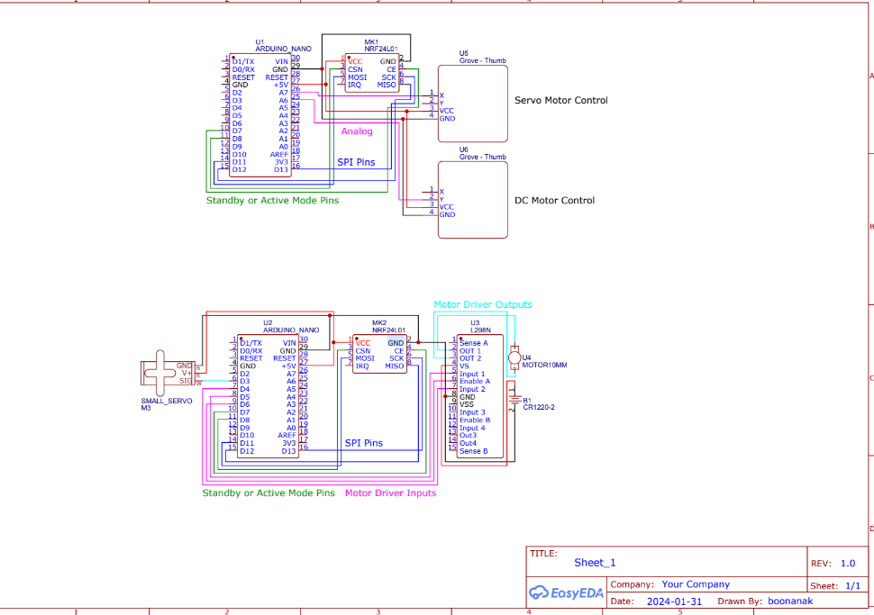
Schematic for Review
(See Repo for updated one)

Slide 6
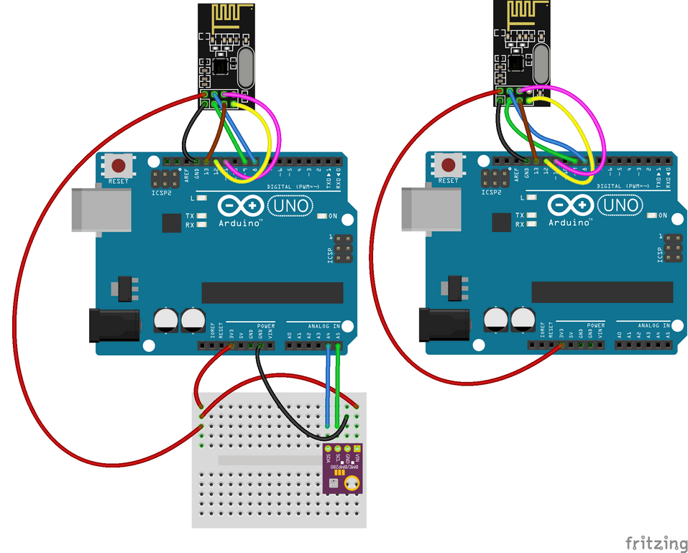
ARDUINO NANO COMMUNICATION
General Tips
Board is NOT a nano! It will actually come up as an Arduino Uno R3
Remember to initialize serial in void setup, (likely to 9600)
We have a regular Arduino Uno if needed for debugging purposes

Slide 7
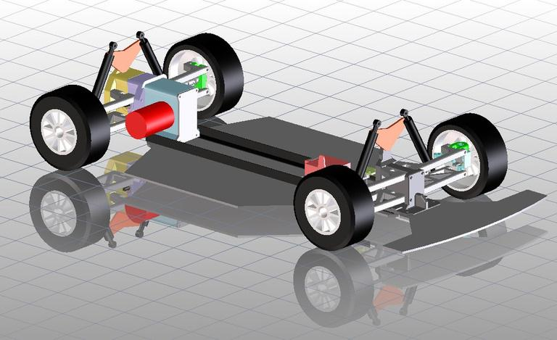
Using Onshape
Direction
Talk to Zegna! He has experience using cad and may recommend using something else instead
Try making different designs first just to familiarize yourself with the software, these do not have to be related to the RC car project
After you are familiar with Onshape, then move to designing the body of the car

Slide 8
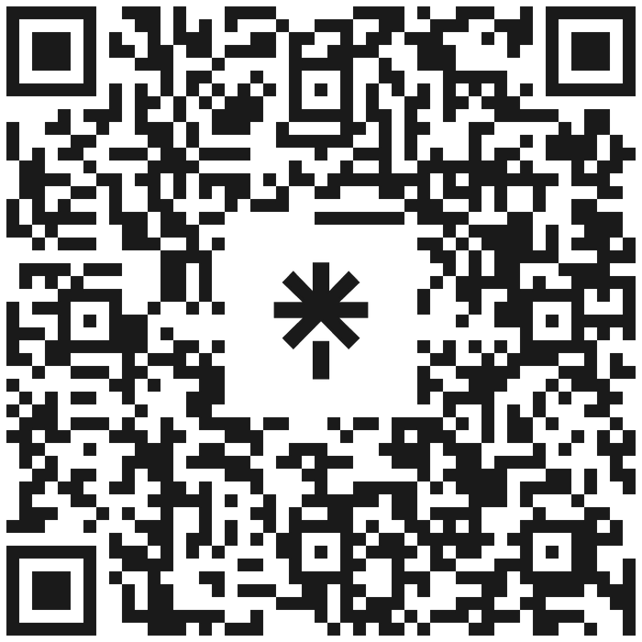



NEW LINKTREE
FOLLOW THE INSTAGRAM AND JOIN THE DISCORD FOR ANNOUNCEMENTS AND INFORMATION

Slide 9
Accomplishments: Fundraiser planning
Switching control tech to bluetooth/xbox?
Same mtg time next quarter
Find a foldable table

